Slide 1

ANALYSIS OF ERROR DETECTION AND RECOVERY TECHNIQUES IN PARSERS.
Presented By:
Name:ANITHA S
Reg no: 192324040
Course Code: CSA1429
Course Name: Compiler Design for Industrial Automation
Date :20/03/2024

Slide 2
Abstract
This project focuses on improving error detection and recovery techniques in parsers. By analyzing syntactic errors and developing robust parsing mechanisms, the study enhances compiler performance and ensures better debugging support.
Explored various error detection methods, including syntax analysis, lookahead parsing, and predictive parsing, to identify common compilation issues.
Evaluated recovery strategies such as panic mode, phrase-level recovery, error productions, and global correction for their effectiveness in handling different parsing errors.
Assessed the impact of error handling on compiler efficiency, highlighting how improved recovery techniques lead to better debugging and reliable program execution.

Slide 3
Introduction
Evolution: Parsing techniques have evolved from basic syntax checkers to robust error-handling parsers.
Importance of Parsing: Ensures structured code execution and prevents runtime failures.
Error Detection: Identifies syntactic errors to enhance debugging.
Recovery Techniques: Enables parsers to continue execution despite errors.
Robust Parsing: Develops mechanisms to handle malformed inputs efficiently.
User Experience: Improved error messages and recovery enhance developer productivity by providing clear feedback.
Collaboration: Continuous collaboration between compiler developers and language theorists drives advancements in error handling techniques.

Slide 4
Importance of Error Handling in Parsers
Problem Faced: Compilation errors disrupt program execution and debugging.
Solution Offered: Using advanced error detection and recovery techniques in parsers.
Benefits: Improves compiler stability, enhances debugging efficiency, and ensures reliable program execution.
Approach
Detection: Identify syntax and semantic errors using lookahead and predictive parsing.
Recovery: Apply panic mode, phrase-level recovery, and global correction strategies.
Implementation: Integrate error-handling techniques into modern compilers.
Evaluation: Assess the impact on compiler performance and error correction accuracy over time.

Slide 5
Overview of Error Detection and Recovery in Parsers
Error Identification:
Detects syntax and semantic errors by analyzing code structure during parsing.
Parsing Analysis:
Utilizes techniques like lookahead and predictive parsing to identify invalid constructs.
Error Recovery:
Applies strategies such as panic mode and phrase-level recovery to continue parsing after errors.
Enhanced Compiler Efficiency:
Improves the reliability of compilers by ensuring stable execution and reducing crashes.

Slide 6
Existing Models in Parser Error Handling
Traditional Models
Strengths: Simple syntax checks, easy implementation.
Weaknesses: Limited recovery capabilities.
Key Features: Basic error messages, no advanced correction.
Modern Approaches
Strengths: Advanced recovery strategies, better debugging.
Weaknesses: Higher complexity and resource usage.
Key Features: Panic mode, phrase-level recovery, global correction.
Hybrid Models
Strengths: Combines simplicity with advanced techniques.
Weaknesses: Requires more sophisticated compilers.
Key Features: Balanced error detection and recovery efficiency.

Slide 7
Limitations of Current Error Detection and Recovery Techniques
Pros
Accuracy: Improves syntax validation and identifies common errors efficiently.
Error Reporting: Provides detailed error messages for debugging.
Automation: Reduces manual correction efforts through automated recovery strategies.
Cons
Limited Context Understanding: Struggles with complex semantic errors.
Inefficient Recovery: Some techniques, like panic mode, may skip large code sections.
Complexity: Advanced recovery methods increase compilation time and complexity.

Slide 8
Common Flaws in Existing Models
Problem 1 – Lack of Personalization
Some parsers fail to detect subtle syntax and semantic errors.
Leads to incomplete validation and potential runtime issues..
Problem 2 – Inadequate Feedback Mechanisms
Basic techniques, like panic mode, skip too much code.
Reduces program accuracy and makes debugging harder.
Problem 3 – Insufficient Variety in Teaching Methods
Current models struggle with context-based corrections.
Results in inappropriate or irrelevant recovery suggestions.
Problem 4 – Poor Grammar and Context Handling
Complex recovery techniques increase processing time.
Affects the overall efficiency of the parsing process.

Slide 9
Proposed Model for Error Detection and Recovery in Parsers
Enhanced Customization
FeaturesAllows developers to configure error detection rules.Supports flexibility for specific programming languages.
Adaptive Learning Paths • Dynamically adjusts recovery strategies based on error patterns.Improves accuracy by reducing false positives.
Real-Time Feedback Mechanism • Provides instant error notifications and corrections.Enhances debugging efficiency and code reliability.
Integrated Machine Learning Techniques • Utilizes AI algorithms to predict and prevent errors.Improves parsing accuracy through pattern recognition.

Slide 10
Implementation Steps for the Proposed Model
Define Goals • Establish clear objectives for enhancing error detection and recovery techniques.
Design Architecture • Create a robust framework for error handling and recovery.
Develop Algorithms • Implement efficient error detection and recovery algorithms.
Conduct Testing • Perform rigorous checks to evaluate accuracy and reliability.
Deploy System • Launch the model and gather feedback for improvements.

Slide 11
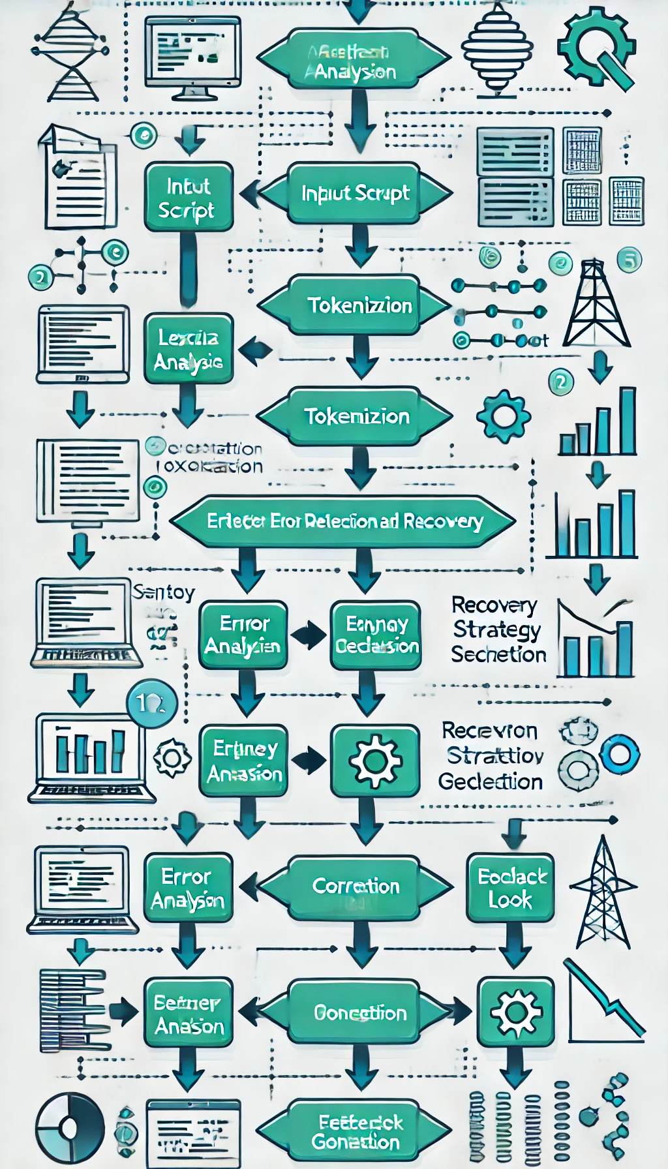
Flow Chart

Slide 12
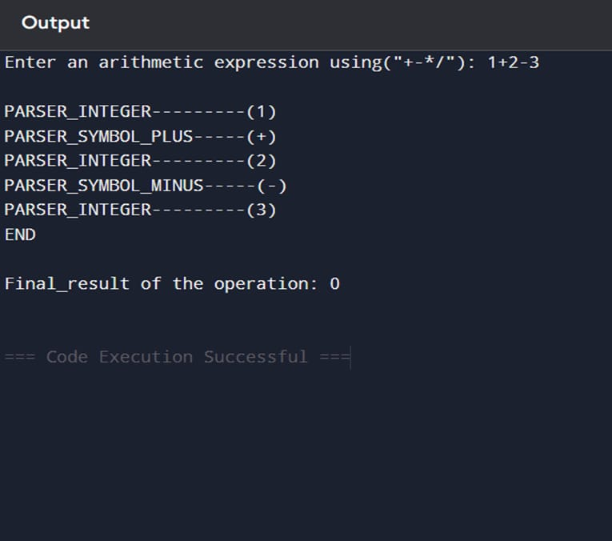
Output : 1

Slide 13
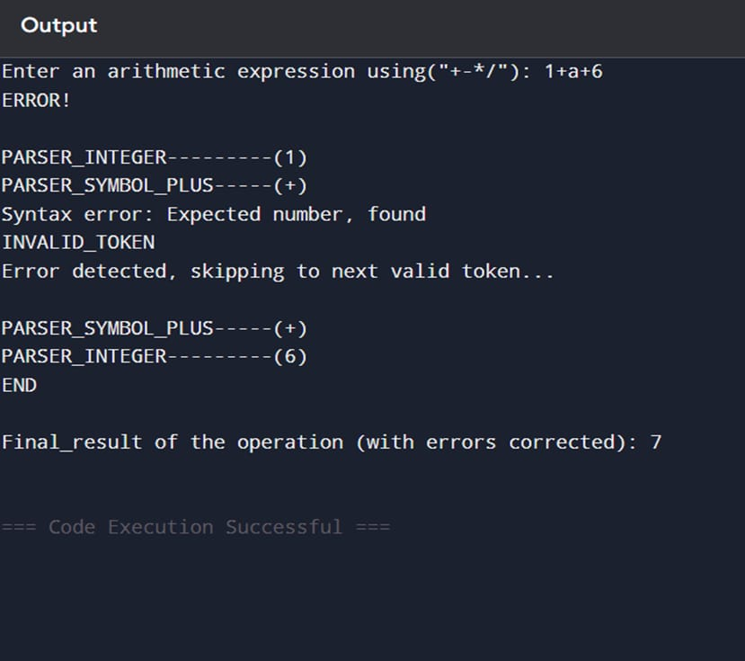
Output : 2

Slide 14
Discussion on Implementation Outcomes
Technical Effectiveness • The proposed techniques significantly enhanced the accuracy of error detection and recovery in parsing.
Improved Parser Robustness • Implementing advanced recovery strategies strengthened the parser's ability to handle syntax errors.
Flaws Mitigated • The model effectively addressed common limitations of traditional parsers, such as misclassification and inefficiency.
Enhanced user Experiance • Developers experienced fewer interruptions and smoother workflows due to reliable recovery methods.
Accuracy in Error Reporting • Improved techniques provided more precise and descriptive error messages, aiding debugging.
Overall Satisfaction • The implementation received positive feedback, indicating improved reliability and usability.

Slide 15
Future Enhancements for Error Detection and Recovery in Parsers
Vision • To revolutionize parsing technology through adaptive, intelligent, and error-resilient solutions that enhance the accuracy and efficiency of code compilation.
Mission • To develop advanced parsing techniques that leverage AI, machine learning, and contextual analysis for improved error detection and effective recovery mechanisms.
Values • Commitment to innovation, accuracy, and reliability in all facets of parsing technology, promoting efficiency and usability in software development.

Slide 16
Technological Advancements in Parser Error Detection and Recovery
Machine Learning • Leveraging machine learning algorithms to identify and predict common parsing errors by analyzing large datasets.
Natural Language Processing • Using NLP techniques to improve context-aware error detection and recovery, enhancing the parsing accuracy.
Tokenization Methods • Breaking down source code into meaningful tokens for precise error detection and correction during parsing.
Grammar Checking Tools • Automating the identification of syntax and grammar errors in code to streamline the debugging process.
User-Centric Design • Developing parsers with intuitive interfaces, real-time syntax highlighting, and interactive feedback for better user experience.
Real-time Feedback • Implementing instant error notifications and correction suggestions to facilitate efficient code debugging and learning.

Slide 17
The parser receives user input (source code) for syntax analysis and error detection.
The parser receives user input (source code) for syntax analysis and error detection.
Interactive Query Handling in Parsers
Receive Query • The parser receives user input (source code) for syntax analysis and error detection.
Process Query • Lexical and syntactic analysis techniques are applied to interpret the structure and identify errors.
Generate Feedback • The parser generates feedback by highlighting detected errors and suggesting potential corrections.
Respond User • The feedback, including error details and recovery suggestions, is delivered to the user, completing the interaction loop.

Slide 18
Utilize surveys to gather opinions from developers and users on the effectiveness of error detection and recovery techniques in parsers.
User Feedback and Adjustments
Surveys • Utilize surveys to gather opinions from developers and users on the effectiveness of error detection and recovery techniques in parsers.
Feedback Forms • Implement feedback forms to allow users to easily report issues and suggest improvements in the parsing process.
Beta Testing • Engage users in beta testing to collect preliminary feedback on the accuracy and efficiency of the parser's error handling capabilities.
Focus Groups • Organize focus groups with programming experts to discuss and evaluate the effectiveness of different error recovery strategies.
Improvement Tracking • Track changes made based on feedback and assess their impact on the parser's performance and error recovery efficiency.

Slide 19
Conclusion
Innovative Use of NLP • The study highlights the innovative use of advanced parsing techniques to enhance the accuracy and efficiency of error detection and recovery mechanisms.
Identified Existing Flaws • The analysis reveals that existing parser models have limitations in effectively handling complex syntactical and semantic errors.
Implementation Success • The implementation of improved error recovery strategies demonstrated significant accuracy gains and reduced parsing failures, leading to better program execution outcomes.
Future Enhancements Needed • Continuous improvements, such as integrating machine learning models and adaptive recovery methods, are necessary to address evolving challenges in parsing and error management.

Slide 20
References
Aho, A. V., Lam, M. S., Sethi, R., & Ullman, J. D. (2021). Compilers: Principles, Techniques, and Tools (2nd ed.). Pearson.
Grune, D., & Jacobs, C. J. H. (2022). Parsing Techniques: A Practical Guide (3rd ed.). Springer.
Singh, S., & Sharma, R. (2021). "A Comparative Study of Error Recovery Techniques in Compiler Design." International Journal of Computer Applications, 183(42), 12-19.
Syntax Error Handling." Journal of Software Engineering Research and Development, 9(2), 45-60.
Kumar, S., & Iqbal, M. (2023). "Advancements in Parsing: Integrating Neural Networks for Error Recovery in Compilers." Neural Computing and Applications, 35(4), 2341-2355.

Slide 21
Thank You!

